Slide 1
JDK and NetBeans
Download, Installation and Setup

Slide 2
Summary: Long Story Cut Short
Download and Install Oracle JDK
https://www.oracle.com/java/technologies/javase-downloads.html
Download and Install Apache NetBeans
https://netbeans.apache.org/download/nb124/nb124.html
Start Apache NetBeans (double click the desktop shortcut icon)
New Project → Java with Ant → Java Application
Follow the Prompts to Install NetBeans Plugins and Features
Notes:
http://ftp.cuhk.edu.hk/pub/packages/apache.org/netbeans/netbeans/12.0/Apache-NetBeans-12.0-bin-windows-x64.exe
Some of you may be interested in checking this:
NetBeans Menu Tools → Java Platforms → Javadoc → Add URL…
https://docs.oracle.com/en/java/javase/14/docs/api/java.base/
https://docs.oracle.com/en/java/javase/14/docs/api/java.desktop/

Slide 3
Java Technology and Licensing
Java™ is a technology licensed by Oracle
Commercial use requires an OTN license, not free!
"Personal" use of official JDK is permissible!!
Also, Oracle "donated" and moved to OpenJDK and Apache NetBeans, some free open-source projects
Notes:
OTN License: Oracle Technical Network License

Slide 4
Download from the Right Source
RECOMMENDED for Personal use: Oracle JDK
https://www.oracle.com/java/technologies/javase-downloads.html
Java SE Development Kit (JDK) 16.0.2 released on 2021.
EASY WAY: Installer Provided
If you are in doubt about the legal issues, consider OpenJDK
http://jdk.java.net/16/
JDK 16.0.2 General-Availability Release as of 2021
Unzip to your applications/ programs folder, Windows e.g.:
C:\Program Files\Java\jdk-16.0.2\
Add "C:\Program Files\Java\jdk-16.0.2\bin\" to system PATH
Optional: setup JAVA_HOME environment variable
See https://javatutorial.net/set-java-home-windows-10
Notes:
time ?

Slide 5
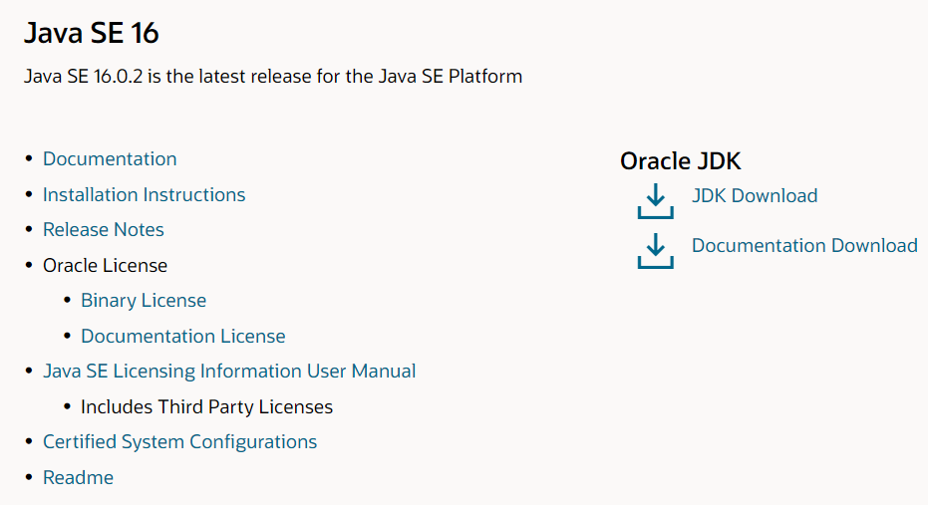
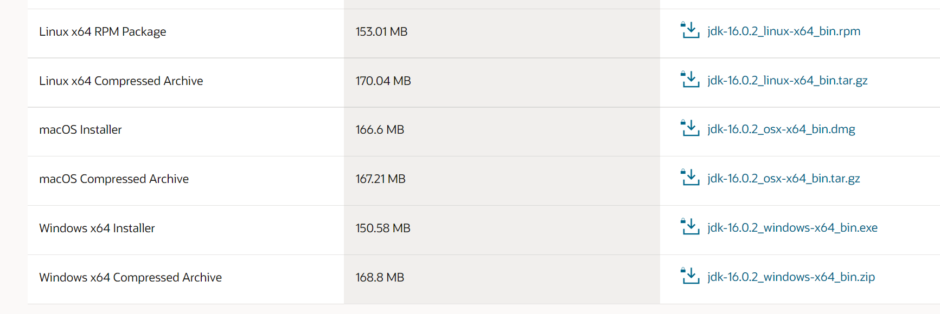
Download Oracle JDK (RECOMMENDED)
https://www.oracle.com/java/technologies/javase-downloads.html
1
2

Slide 6
Windows: Edit environment variable “path”
Summary steps for Windows 10:
Open “Control Panel” -> “System” -> “Advanced system settings”
“Advanced” -> “Environment Variables”
Select “Path” in “User variables” -> “Edit…”
“New” a value, and input your JDK path
For example, “C:\Program Files\Java\jdk-16.0.2\bin”
Click “OK” to save your configuration

Slide 7
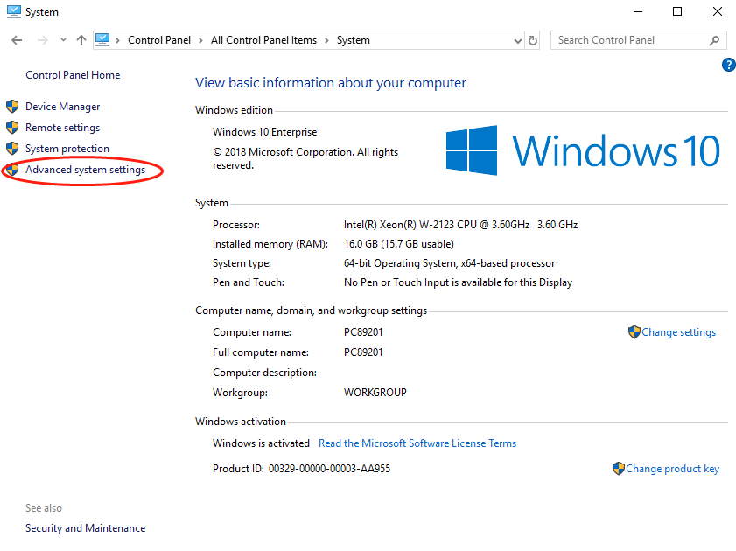
Windows: Edit environment variable “path”

Slide 8
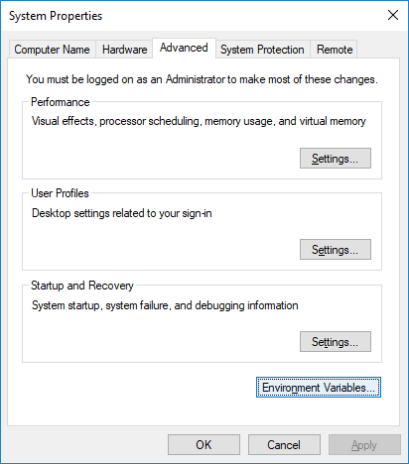
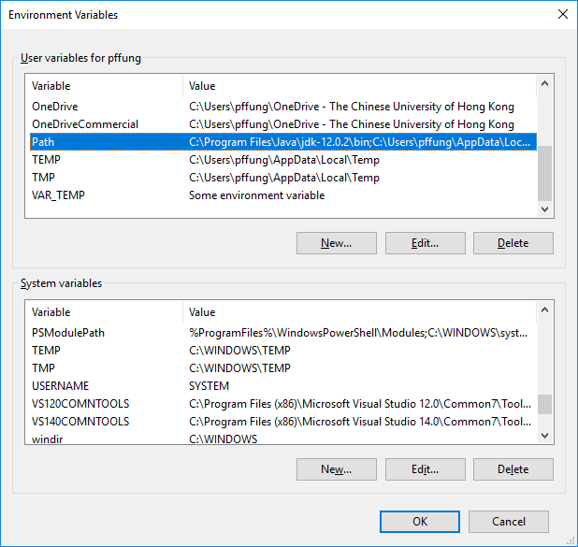
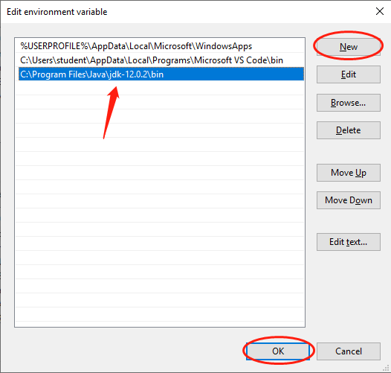
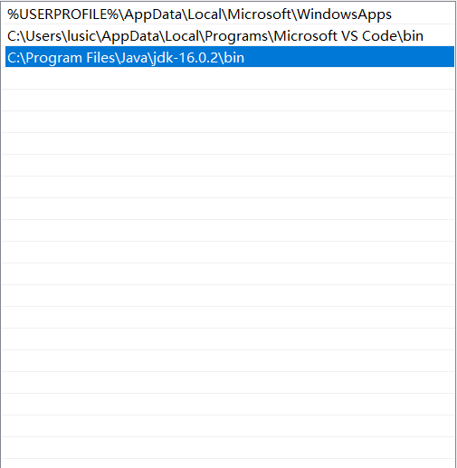
Windows: Edit environment variable “path”

Slide 9
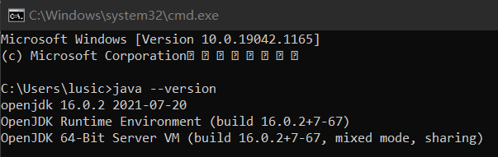
Windows: Edit environment variable “path”
To check whether it is configured correctly, start command prompt by running “cmd” in “ R” (Run), and execute “java --version”

Slide 10
Apache NetBeans IDE 12.4
Recommend Apache NetBeans 12.4 as of 2021 (Installer Provided!)
https://netbeans.apache.org/download/nb124/nb124.html
Download from CUHK FTP mirror site:
http://ftp.cuhk.edu.hk/pub/packages/apache.org/netbeans/netbeans/12.4/Apache-NetBeans-12.4-bin-windows-x64.exe
Oracle JDK users may run the installer directly!

Slide 11
Apache NetBeans IDE 12.4
Some users may have difficulty in running the Apache NetBeans 12.4 installer directly on Windows
Workaround: run the installer using a command line on Windows, Start → Run ( R):
%USERPROFILE%\Downloads\Apache-NetBeans-12.4-bin-windows-x64.exe --javahome "C:\Program Files\Java\jdk-16.0.2"

Slide 12
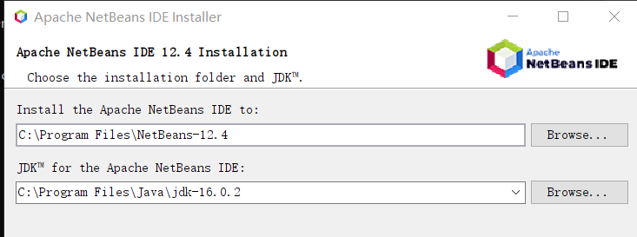
Apache NetBeans IDE 12.4: Tips on Windows
When installing NetBeans 12.4 on Windows, you may also customize the JDK path here. It’s a good idea to check whether this path is identical to the JDK path installed before.

Slide 13
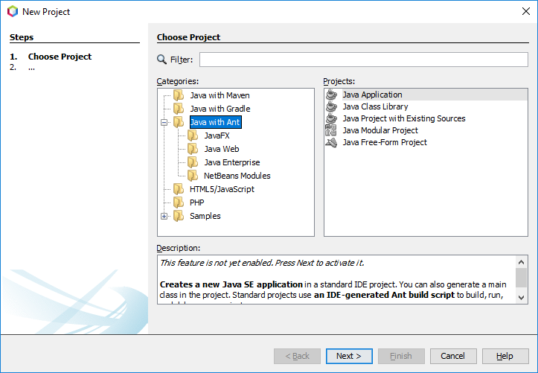
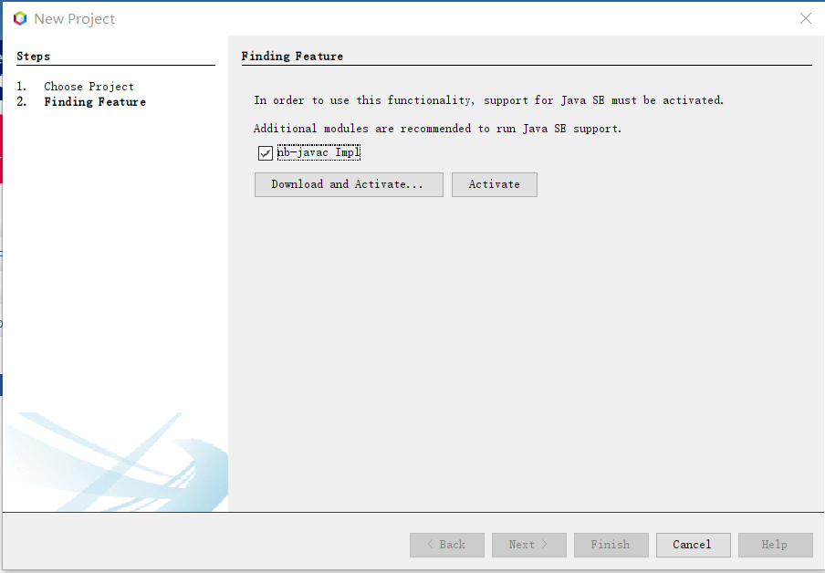
Start NetBeans → New Project

Slide 14
Possible Scenario: Features
On creating your first NetBeans New Project → Java with Ant → Java Application
You are prompted to download Java SE support, "nbjavac-Library" plugin and some features, do so.
Download and Activate…

Slide 15
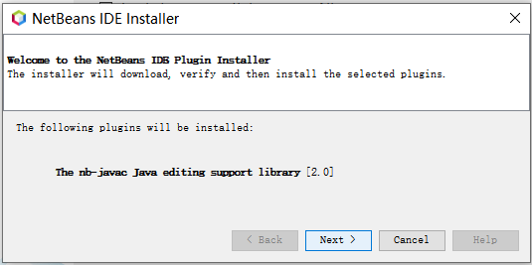
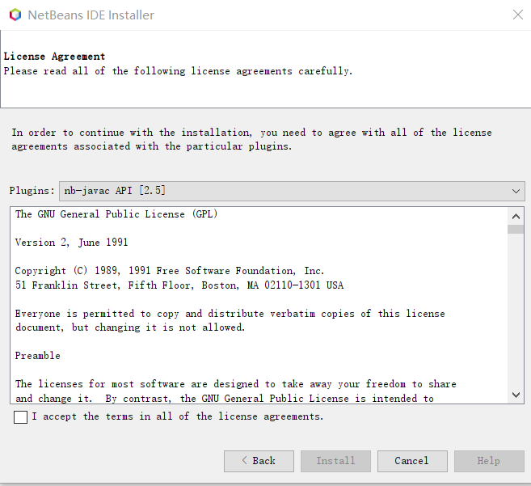
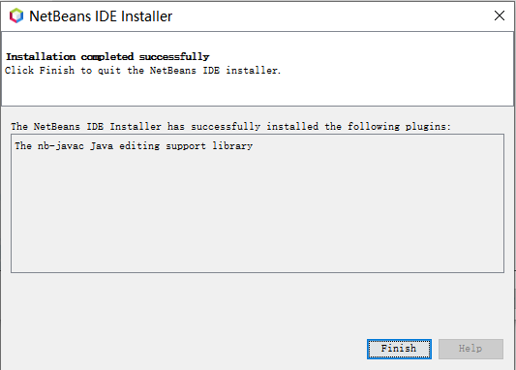
NetBeans Plugin Installer
✓
Tips: After nbjavac is installed, we may need to wait a minute until it goes to the next step.

Slide 16
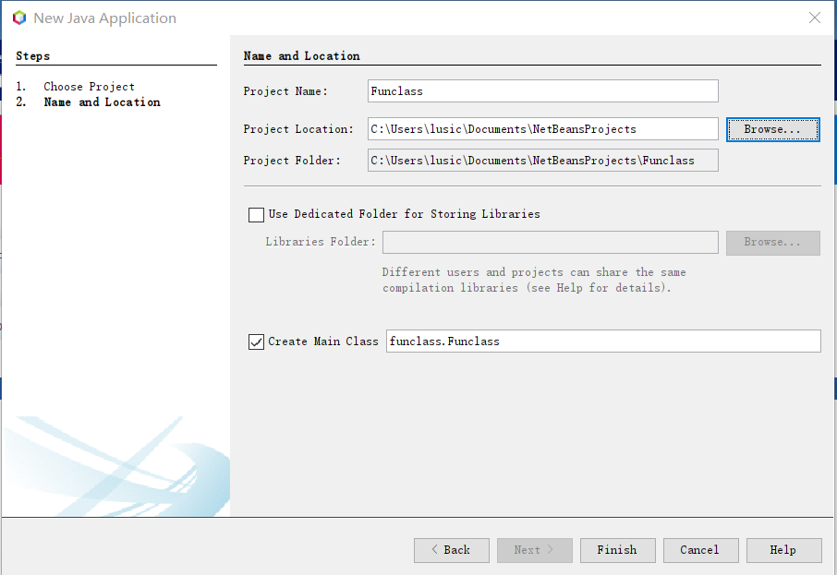
NetBeans New Java Application

Slide 17

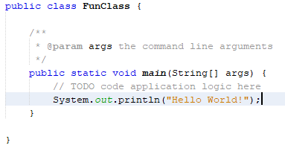
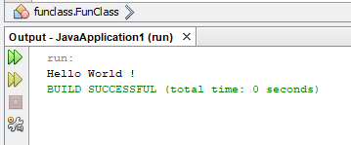
NetBeans New Java Application
You may use a println() to output “Hello World!”
System.out.println(“Hello World!”);
Run the program, and check the output

Slide 18
Java Documentation
JDK Documentation
https://docs.oracle.com/en/java/javase/16/
Download a ZIP for offline use:
https://www.oracle.com/java/technologies/javase-jdk16-doc-downloads.html
Application Programming Interface (API) Doc:
https://docs.oracle.com/en/java/javase/16/docs/api/index.html

Slide 19
Setup JDK Online Javadoc for ALL APIs by Hand for NetBeans…
Run these TWO commands:
mkdir %USERPROFILE%\AppData\Roaming\NetBeans\12.4\config\Services\Platforms\org-netbeans-api-java-Platform
Notepad %UserProfile%\AppData\Roaming\NetBeans\12.4\config\Services\Platforms\org-netbeans-api-java-Platform\default_platform.xml
Save the following content into the XML configuration file…

Slide 20
<?xml version="1.0" encoding="UTF-8"?>
<!DOCTYPE platform PUBLIC "-//NetBeans//DTD Java PlatformDefinition 1.0//EN" "http://www.netbeans.org/dtds/java-platformdefinition-1_0.dtd">
<platform default="yes" name="JDK 16 (Default)">
<properties>
<property name="platform.ant.name" value="default_platform"/>
</properties>
<javadoc>
<resource>https://docs.oracle.com/en/java/javase/16/docs/api/java.base/</resource>
<resource>https://docs.oracle.com/en/java/javase/16/docs/api/java.compiler/</resource>
<resource>https://docs.oracle.com/en/java/javase/16/docs/api/java.datatransfer/</resource>
<resource>https://docs.oracle.com/en/java/javase/16/docs/api/java.desktop/</resource>
<resource>https://docs.oracle.com/en/java/javase/16/docs/api/java.instrument/</resource>
<resource>https://docs.oracle.com/en/java/javase/16/docs/api/java.logging/</resource>
<resource>https://docs.oracle.com/en/java/javase/16/docs/api/java.management/</resource>
<resource>https://docs.oracle.com/en/java/javase/16/docs/api/java.management.rmi/</resource>
<resource>https://docs.oracle.com/en/java/javase/16/docs/api/java.naming/</resource>
<resource>https://docs.oracle.com/en/java/javase/16/docs/api/java.net.http/</resource>
<resource>https://docs.oracle.com/en/java/javase/16/docs/api/java.prefs/</resource>
<resource>https://docs.oracle.com/en/java/javase/16/docs/api/java.rmi/</resource>
<resource>https://docs.oracle.com/en/java/javase/16/docs/api/java.scripting/</resource>
<resource>https://docs.oracle.com/en/java/javase/16/docs/api/java.se/</resource>
<resource>https://docs.oracle.com/en/java/javase/16/docs/api/java.security.jgss/</resource>
<resource>https://docs.oracle.com/en/java/javase/16/docs/api/java.security.sasl/</resource>
<resource>https://docs.oracle.com/en/java/javase/16/docs/api/java.smartcardio/</resource>
<resource>https://docs.oracle.com/en/java/javase/16/docs/api/java.sql/</resource>
<resource>https://docs.oracle.com/en/java/javase/16/docs/api/java.sql.rowset/</resource>
<resource>https://docs.oracle.com/en/java/javase/16/docs/api/java.transaction.xa/</resource>
<resource>https://docs.oracle.com/en/java/javase/16/docs/api/java.xml/</resource>
<resource>https://docs.oracle.com/en/java/javase/16/docs/api/java.xml.crypto/</resource>
<resource>https://docs.oracle.com/en/java/javase/16/docs/api/jdk.accessibility/</resource>
<resource>https://docs.oracle.com/en/java/javase/16/docs/api/jdk.attach/</resource>
<resource>https://docs.oracle.com/en/java/javase/16/docs/api/jdk.charsets/</resource>
<resource>https://docs.oracle.com/en/java/javase/16/docs/api/jdk.compiler/</resource>
<resource>https://docs.oracle.com/en/java/javase/16/docs/api/jdk.crypto.cryptoki/</resource>
<resource>https://docs.oracle.com/en/java/javase/16/docs/api/jdk.crypto.ec/</resource>
<resource>https://docs.oracle.com/en/java/javase/16/docs/api/jdk.dynalink/</resource>
<resource>https://docs.oracle.com/en/java/javase/16/docs/api/jdk.editpad/</resource>
<resource>https://docs.oracle.com/en/java/javase/16/docs/api/jdk.hotspot.agent/</resource>
<resource>https://docs.oracle.com/en/java/javase/16/docs/api/jdk.httpserver/</resource>
<resource>https://docs.oracle.com/en/java/javase/16/docs/api/jdk.jartool/</resource>
<resource>https://docs.oracle.com/en/java/javase/16/docs/api/jdk.javadoc/</resource>
<resource>https://docs.oracle.com/en/java/javase/16/docs/api/jdk.jcmd/</resource>
<resource>https://docs.oracle.com/en/java/javase/16/docs/api/jdk.jconsole/</resource>
<resource>https://docs.oracle.com/en/java/javase/16/docs/api/jdk.jdeps/</resource>
<resource>https://docs.oracle.com/en/java/javase/16/docs/api/jdk.jdi/</resource>
<resource>https://docs.oracle.com/en/java/javase/16/docs/api/jdk.jdwp.agent/</resource>
<resource>https://docs.oracle.com/en/java/javase/16/docs/api/jdk.jfr/</resource>
<resource>https://docs.oracle.com/en/java/javase/16/docs/api/jdk.jlink/</resource>
<resource>https://docs.oracle.com/en/java/javase/16/docs/api/jdk.jshell/</resource>
<resource>https://docs.oracle.com/en/java/javase/16/docs/api/jdk.jsobject/</resource>
<resource>https://docs.oracle.com/en/java/javase/16/docs/api/jdk.jstatd/</resource>
<resource>https://docs.oracle.com/en/java/javase/16/docs/api/jdk.localedata/</resource>
<resource>https://docs.oracle.com/en/java/javase/16/docs/api/jdk.management/</resource>
<resource>https://docs.oracle.com/en/java/javase/16/docs/api/jdk.management.agent/</resource>
<resource>https://docs.oracle.com/en/java/javase/16/docs/api/jdk.management.jfr/</resource>
<resource>https://docs.oracle.com/en/java/javase/16/docs/api/jdk.naming.dns/</resource>
<resource>https://docs.oracle.com/en/java/javase/16/docs/api/jdk.naming.rmi/</resource>
<resource>https://docs.oracle.com/en/java/javase/16/docs/api/jdk.net/</resource>
<resource>https://docs.oracle.com/en/java/javase/16/docs/api/jdk.pack/</resource>
<resource>https://docs.oracle.com/en/java/javase/16/docs/api/jdk.rmic/</resource>
<resource>https://docs.oracle.com/en/java/javase/16/docs/api/jdk.scripting.nashorn/</resource>
<resource>https://docs.oracle.com/en/java/javase/16/docs/api/jdk.sctp/</resource>
<resource>https://docs.oracle.com/en/java/javase/16/docs/api/jdk.security.auth/</resource>
<resource>https://docs.oracle.com/en/java/javase/16/docs/api/jdk.security.jgss/</resource>
<resource>https://docs.oracle.com/en/java/javase/16/docs/api/jdk.xml.dom/</resource>
<resource>https://docs.oracle.com/en/java/javase/16/docs/api/jdk.zipfs/</resource>
</javadoc>
</platform>

Slide 21
Appendix: Installation for Mac
Download Oracle JDK 16.0.2 here:
https://www.oracle.com/java/technologies/javase-downloads.html
Download Apache NetBeans 12.4 here:
https://www.apache.org/dyn/closer.cgi/netbeans/netbeans/12.4/Apache-NetBeans-12.4-bin-macosx.dmg

Slide 22
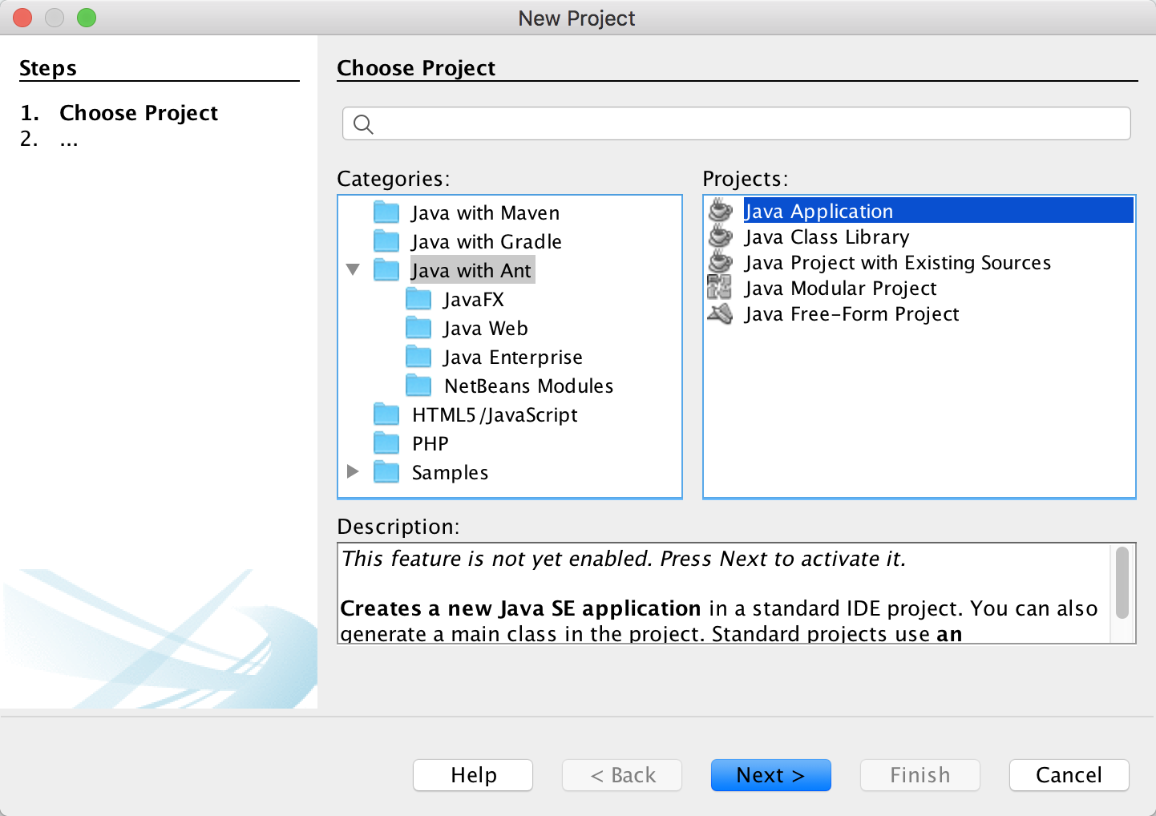
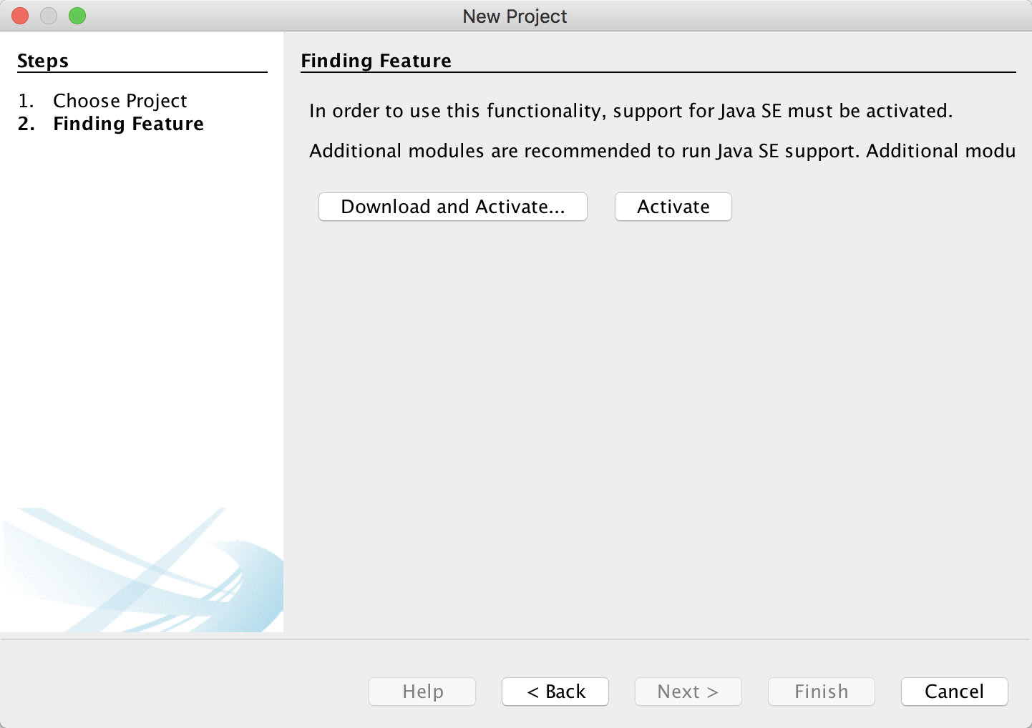
Mac Users: Start NetBeans → New Project

Slide 23
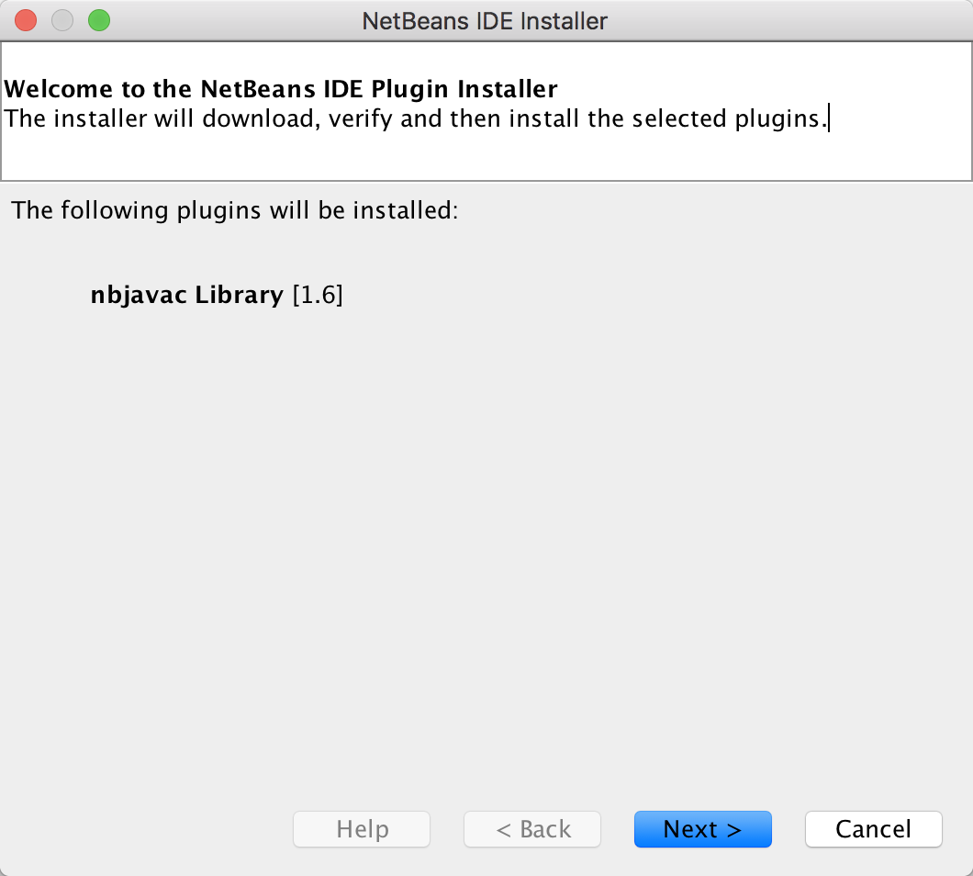
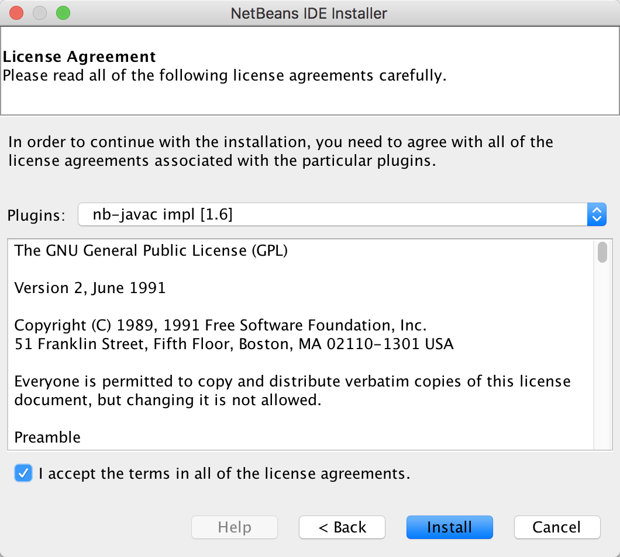
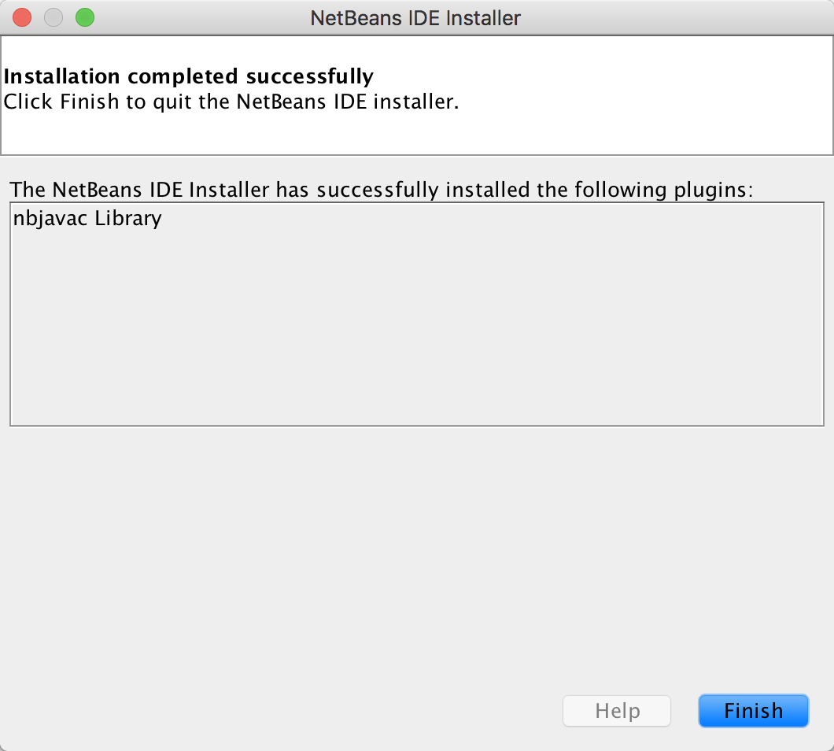
Mac - NetBeans Plugin Installer

Slide 24
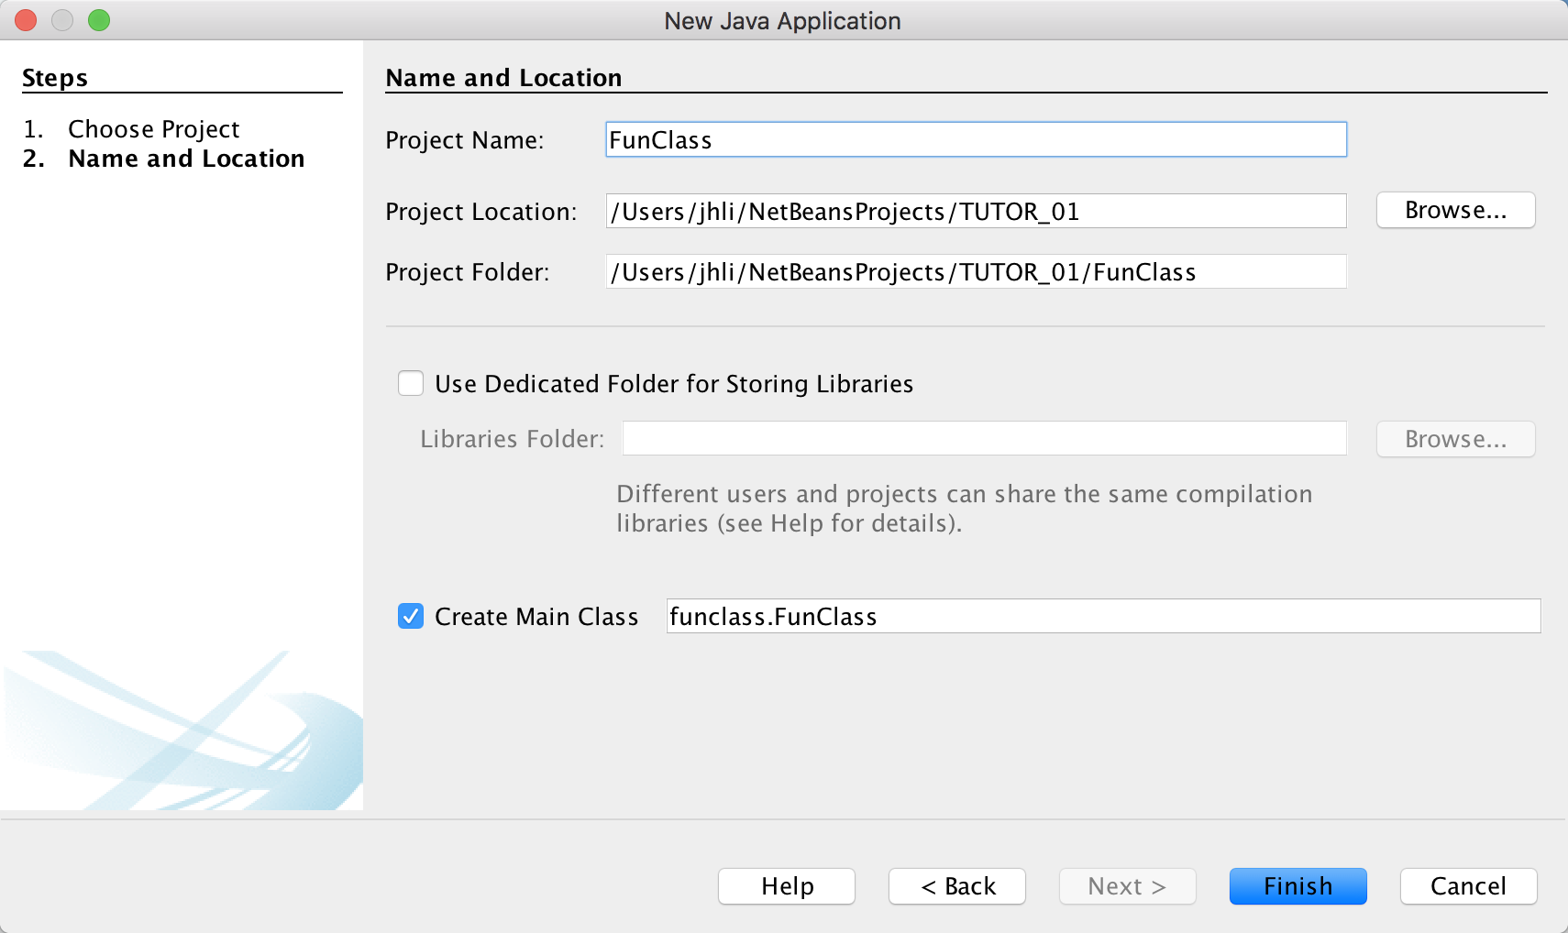
Mac - NetBeans New Java Application

Slide 25
Appendix: JRE
Let clients run our work, but NOT for Development/ Programming
Download and install Java Runtime Environment (JRE)
https://www.java.com/en/
Read and accept Oracle Technology Network License Agreement for Oracle Java SE (for Personal Use)
For Windows, Version 8 Update 301 Release date July 20, 2021

Slide 26
Appendix: Apache NetBeans IDE 12.4
If you do not use the NetBeans installer for Windows, but the ZIP…
Download from CUHK mirror site:
http://ftp.cuhk.edu.hk/pub/packages/apache.org/netbeans/netbeans/12.4/netbeans-12.4-bin.zip
Unzip to your applications/ programs folder, Windows example:
C:\Program Files\NetBeans-12.4\netbeans\
Create a short-cut to C:\Program Files\NetBeans-12.4\netbeans\bin\netbeans64.exe
OpenJDK users shall edit NetBeans configuration file, Windows example:
Run this command (you need Administrator right):
Wordpad "C:\Program Files\NetBeans-12.4\netbeans\etc\netbeans.conf"
Add this line at the end of the text file:
netbeans_jdkhome="C:\Program Files\Java\jdk-16.0.2"

Slide 27
Outcomes
After installing JDK and setting up proper system environment variables such as PATH, we will be able to compile and run Java programs on Command Line Interface (CLI)
After installing Apache NetBeans, we will be able to create Java projects and work on the IDE with Graphical User Interface (GUI)

